Slide 1
Capstone Project Used Car Price Prediction
Machine Learning/Regression
Madoka Fujii
Notes:
Hello, everyone. Thank you for having me. My name is Madoka. I would like to speak about the capstone project, used car price prediction today.

Slide 2
Key takeaways
Uncertainty accuracy of price of used car in India while huge demand
Objective is making a pricing model
Gradient Boost is the best model in the models explored
Next step, possible to try analyzing picture and video for prediction.
Notes:
First of all, I am going to go about the key takeaways.
Used car market is rapidly growing in India now. The price keeps rising dramatically. It is important to solve this problem because there is uncertainty of accuracy of pricing.
Intended goal is making a pricing model. Using the model helps us to make profitable.
This project proposes the Gradient Boost model to solve the current issue.
In the near future, we may be able to try analyzing picture and video for prediction.

Slide 3
Problem Definition
Used car market is rapidly growing in India
The price of used car keeps rising dramatically
Pricing is hard in terms of accuracy and time
Notes:
Problem Definition
Used car market is rapidly growing in India.
The price of used car keeps rising dramatically.
Pricing is hard in terms of accuracy and time.

Slide 4

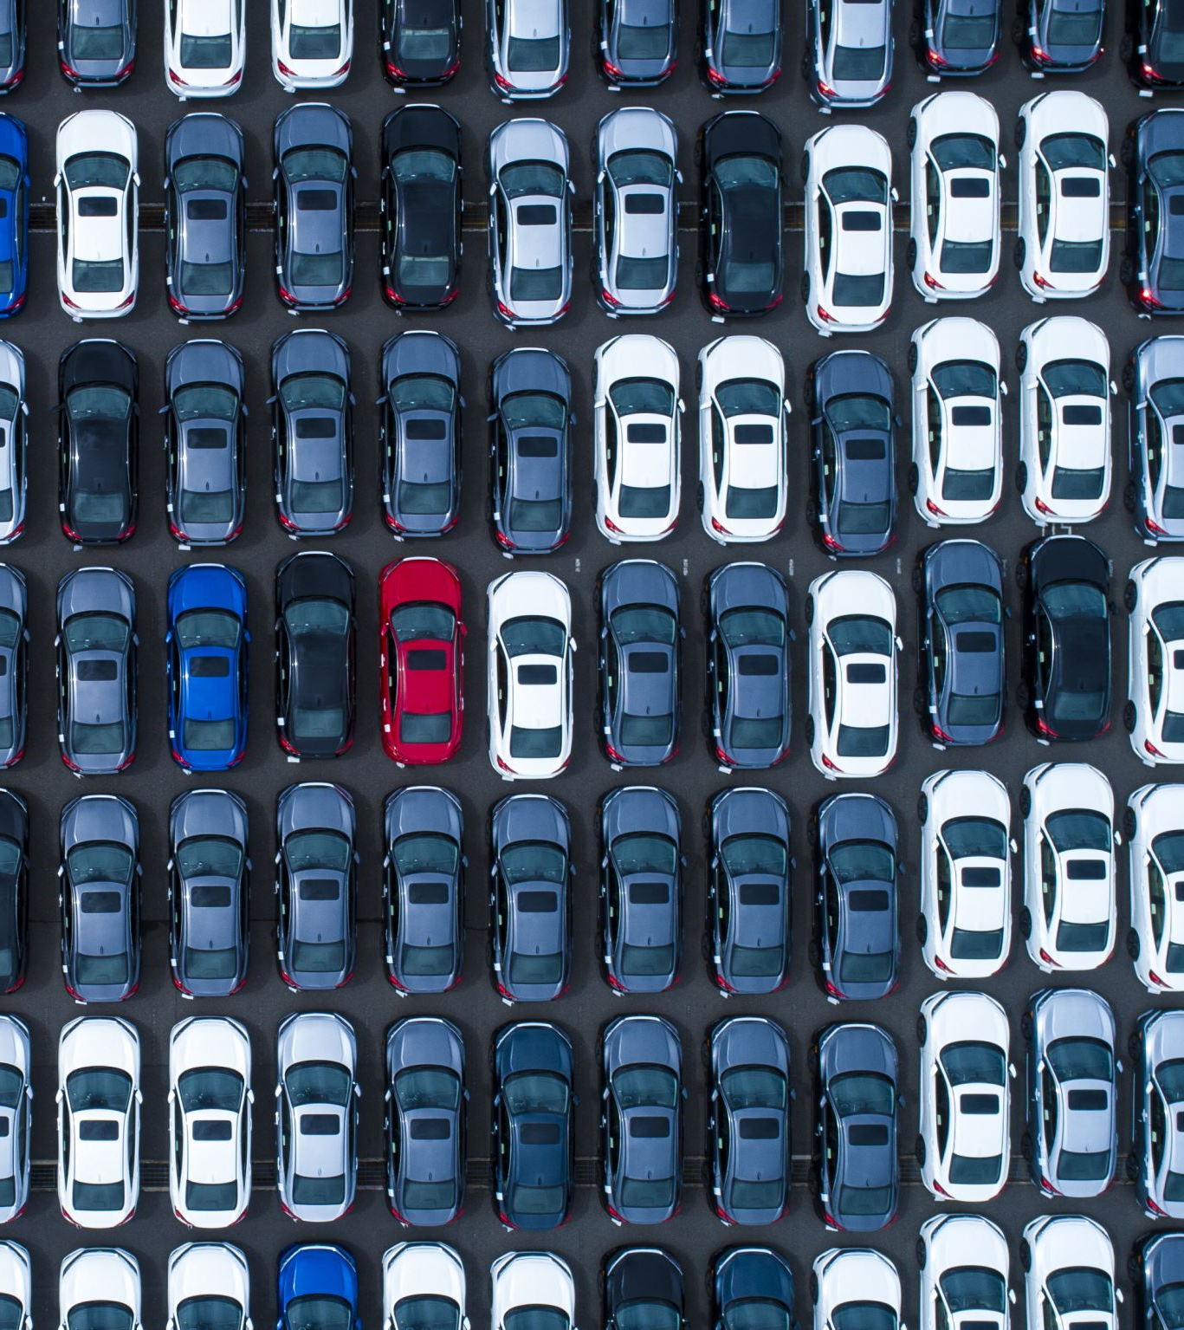
Problem to solve
Need to figure out what is the impact to price of used car.
Can we use machine learning to predict fair price?
Can the pricing model predict price precisely and appropriately?
Notes:
Problem to solve
Need to figure out what is the impact to price of used car.
Can we use machine learning to predict fair price?
Can the pricing model predict price precisely and appropriately.

Slide 5
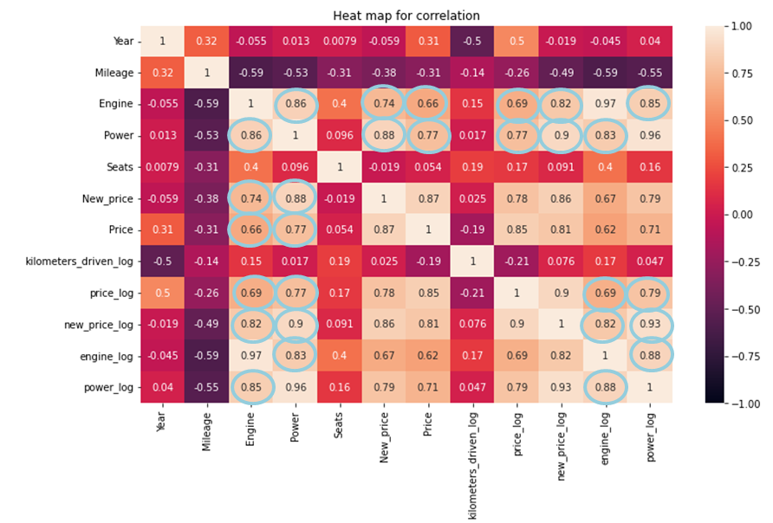
Exploratory data analysis
Engine and Power are highly correlated
The two correlated with Price and price_log as well
Notes:
To figure out how the data inside, I explore the data. What I found is Engine and Power were strongly correlated. And they are also highly correlated with price, price_log, new price, and new-price-log as well. Generally, correlation rate higher is more strongly correlated.

Slide 6
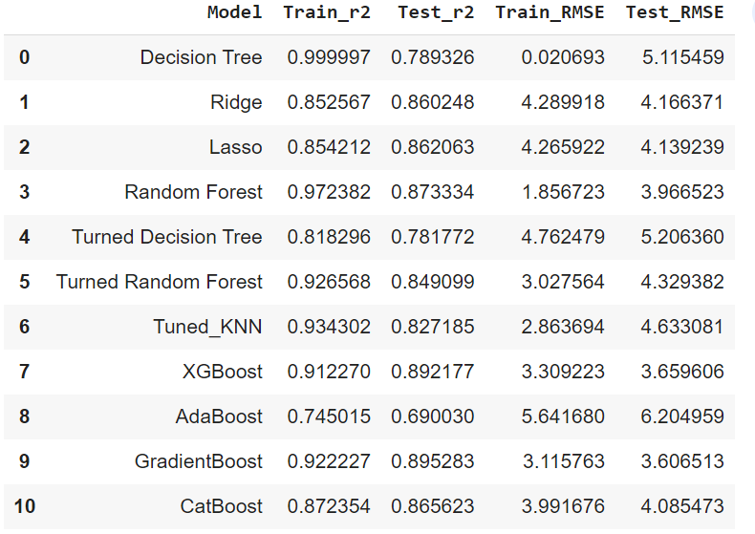
Comparison of Models / Approach for the solution
Notes:
Comparison of models
After the data analysis, I have created 14 models and the table shows 11 models of them.
In term of R2, the XGBoost and GradientBoost have the highest scores. On train data and test data, they are around 0.92 to 0.89. R2 indicates how much the model can explain the data. It is higher is better. The gap between train data and the test data of R2 on each model are also similar approximately 0.03 which is not overfitting. It is a good balance between train data and test data. Usually, under 0.15 is accepted as a good balance. Overfitting means the model is accurate for the train data but not for new data.
The RSME on test data and train data are also relatively lower than other models. it can explain how much the model is accurate. It is lower is better. Overall, RSME is around 3-5 in the models. And the RSME on XGBoost and Gradient model are around 3. They are boosting methods; it minimized loss from previous learning. And it improves the learning in next learning. That’s why they are able to perform well compared to others. They are created with a combination of traditional methods such as decision tree and random forest.

Slide 7
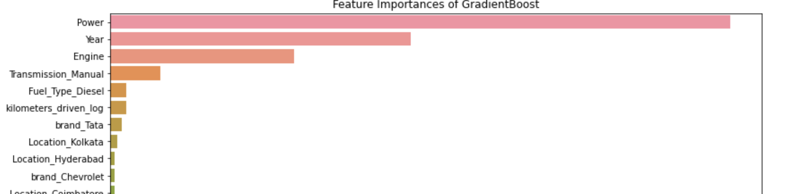
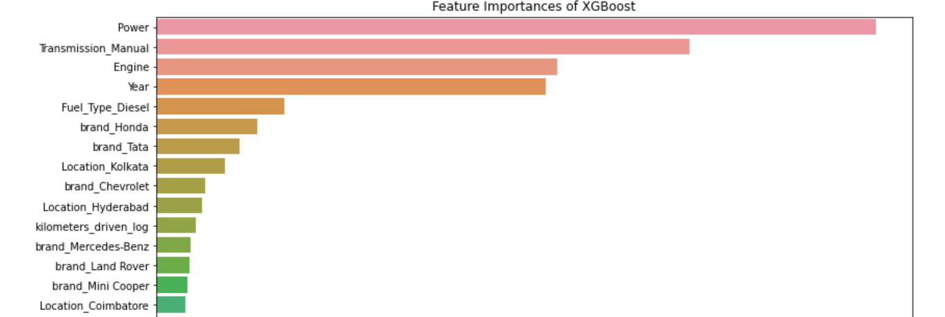
Feature Importance / key findings & insights
XGBoost is highly sensitive to outliers which makes the order of feature importance becomes different from other models
Notes:
Feature Importance
Feature Importance is checking which factor is impacted the model.
The order of most of feature of importance of the models were 1st: Power, 2nd: Year, 3rd:Engine and 4th:Transmissin_Manual.. GradientBoost is following the order.
However, the order of XGBoost was different from others.
The order was 1St: Power, 2nd:Transmission_Manual, 3rd: Engine, 4th:Year. This is because XGBoost is highly sensitive to outliers. That means the coefficient takes the outliers as well. So, the order got different from others.
Outliers can be understood as data points that significantly different from the rest of the data.
If we use XGBoost for our model, we need to have extra process to evaluate and drop outliers which will take time and more cost. It is increasing the possibility to mistake the process that will cause biased data and inaccurate result.

Slide 8
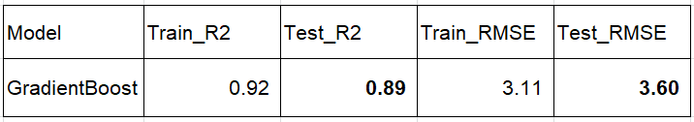
Model Solution
Gradient Boost can predict price the most accurately and have superior explanatory ability data in the models
It is robust to outliers. It does not need to do any extra process to evaluate and drop outliers
Notes:
Model Solution
Gradient Boost is the best model which can predict price with high accuracy and have superior explanatory ability. It has an R-squared of 0.89 on the test data, which means that it can explain 89% variation in our data. Also the RMSE on test data is 3.60 which means we can predict very closely to the original values. This is a very good model and we can use it in production.
It is robust to outliers that can benefit us that we don’t need to do extra process to evaluate and drop outliers.

Slide 9
Recommendations for implementation
Need to improve the accuracy of the model that still have remaining error
Increase the data amount so that it can do more accurate prediction and more profitable
Notes:
Recommendations for implementation
Our model needs to improve the remaining error. That will cause inaccuracy of the result. Even though our model has high accuracy, there are still error is existing. To improve the model, it can be ensemble with other methods. It must be 0% error to use in production.
Large amount of data improves the accuracy of the result.
Bring more “First-Owner” used cars, “Automatic Transmission” used cars, “Engine with High Power” used cars which are profitable according to our data.
And collecting used car information in all over the India will be beneficial and provide better prediction. Which means we can be more profitable.

Slide 10
What are the key risks and challenges?
Accuracy of data: During many detailed processes to create model, it may cause misinterpret data
The pricing model may not right
Notes:
What are the key risks and challenges?
Accuracy of data is one of key risks. To create the model, there are a lot of detailed process. That is easy to misunderstand what the data tells us. It causes inaccuracy of the prediction. That will provide significant loss both our company and our customers. And that will impact to the used car market in India.
The pricing model may not right. The performance of model might not accurate and appropriate. If so, the result will be overfitting, or under fitting. We regularly need to keep the model up-to-date and improve it in order to predict price accurately.

Slide 11
Next Step
Further precise valuation of used car, taking picture or video of the condition (scratches, accidents, or repairs) will be effective. Deep Learning can analyze and predict it. The conditions significantly impact to the car’s price.
Notes:
Next step.
Further precise valuation of used car, it may be able to take a picture or video to see the condition (scratches, accidents, or repairs) Then, evaluate the picture of used car. That will be applied to deep learning. The conditions of used car significantly impact the car’s price.

Slide 12

Thank you! Question?
Notes:
That’s concluding my regression model for used car pricing.
Thank you very much. Any questions?

